Slide 1
SDR Transceivers

Slide 2
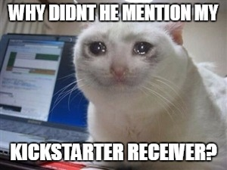
Disclaimer
Will not cover all transceivers
Not endorsing anything
Not endorsing anything

Slide 3
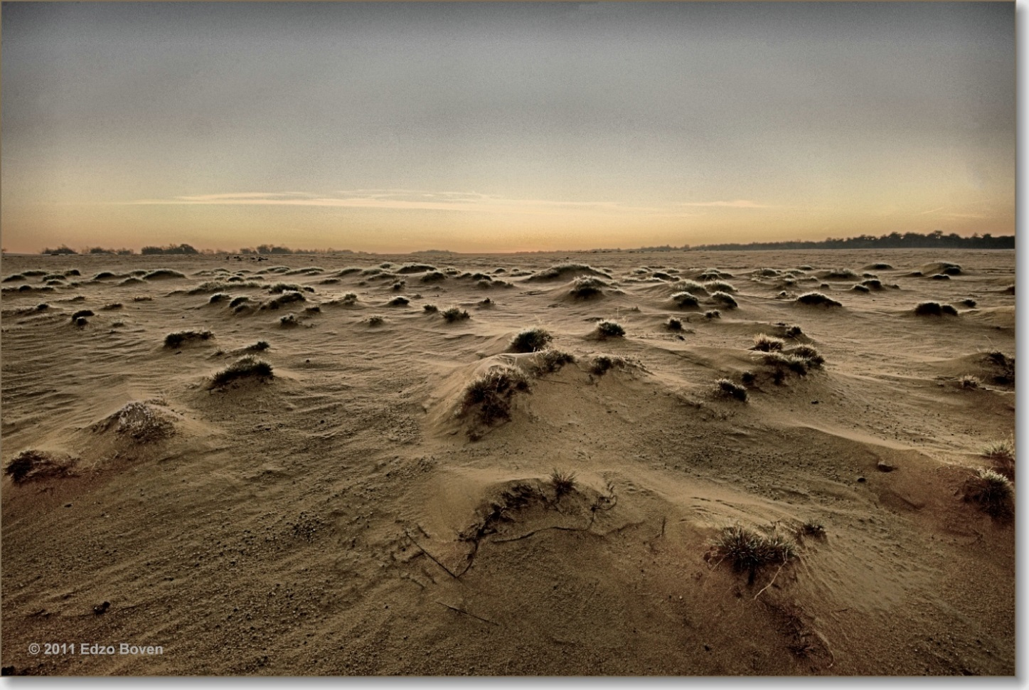
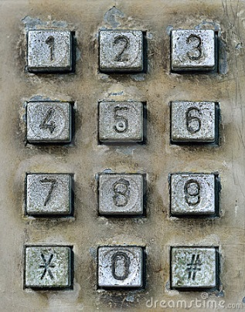
GNURadio without Transceivers
What would GR today be without accessible transceivers?

Slide 4
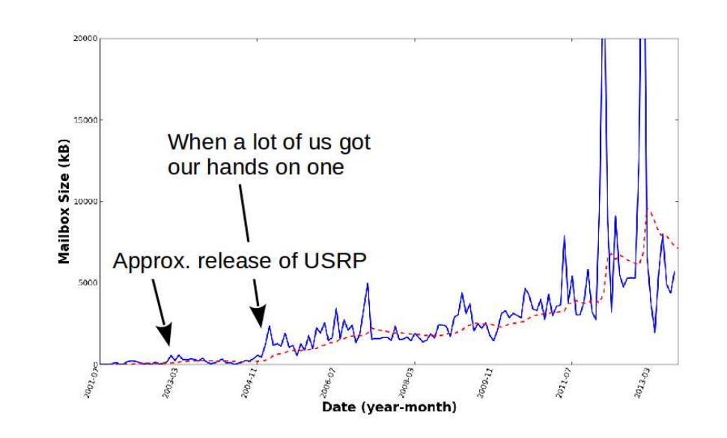
Approx. release of support for RTL dongle

Slide 5
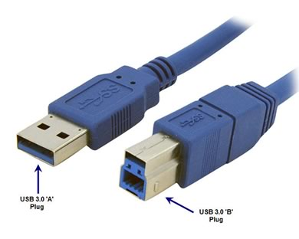
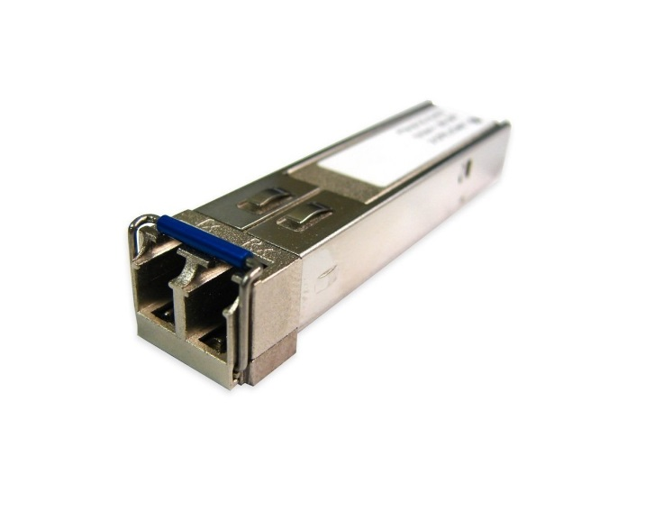
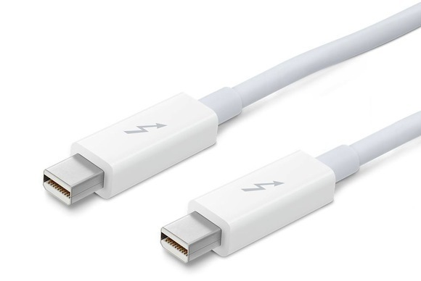
Evolution of moving samples
USB 2.0 – 8 MHz
1 Gig Ethernet – 25 MHz
PCIe (v2) – 100 Mhz per lane *
USB 3.0 – 125 MHz *
10 Gig Ethernet – 250 MHz *
Thunderbolt – 500 MHz *

Slide 6
More Evolution!
Basic TX/RX
WBX
SBX
RTL
E3XX
Dec 2004
Jan 10
Feb 11
Mar 12
Nov 14
TVRX
XCVR
HackRF
UBX
March 05
Feb 09
Mar 13
Feb 15
UmTRX
Apr 13
PocketSDR
DBSRX
CBX
Jun 15
June 05
Jun 13
B2XX
Aug13
2004
2005
2006
2007
2008
2009
2010
2011
2012
2013
2014
2015
2016
LFRX/TX + RFX
SideKiq
Mar 06
BURX
BladeRF
May 14
Mar 10
Jul 13
PicoSDR
Feb 13
1 GHz
3 GHz
5 GHz
0 MHz
6 GHz
2 GHz
4 GHz

Slide 7
Transceivers w/ GNURadio Source/Sink Support
Ettus UHD Devices
B2XX
Freq: 70 MHz – 6 GHz
Resolution: 12-bit
2 Channels
USB 3.0
E3XX
Freq: 70 MHz – 6 GHz
Resolution: 12-bit
2 Channels
Embedded Xilinx Zynq
X3XX
Freq: Daughtercard
Resolution: 14-bit ADC, 16-bit DAC
Bandwidth: 120 MHz
2 Channels
PCIex4, ExpressCard, or 10 GigE
N2XX
Freq: Daughtercard
Resolution: 14-bit ADC, 16-bit DAC
Bandwidth: 25 MHz
Gigabit Ethernet

Slide 8
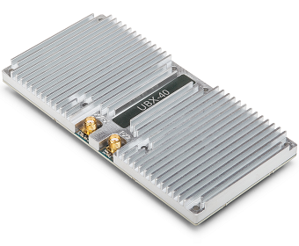
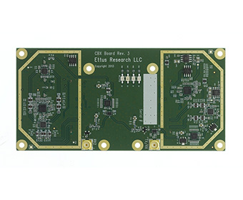
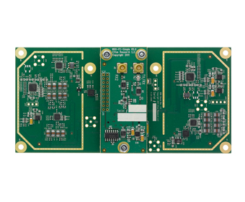
Transceivers w/ GNURadio Source/Sink Support
Ettus UHD Daughtercards
UBX
Freq: 10 MHz – 6 GHz
RF shielding
CBX
Freq: 1.2 GHz – 6 GHz
SBX
Freq: 400 MHz – 4.4 GHz
WBX
Freq: 50 MHz – 2.2 GHz
Granddaughter card
All have 120 MHz X-series options

Slide 9
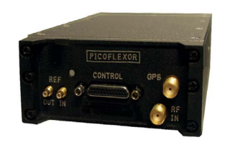
Transceivers w/ GNURadio Source/Sink Support
DRS PicoFlexor
Freq range:
2 MHz – 3 GHz
2 MHz – 12.4 GHz with option
Resolution: 8 bits
Dynamic Range: not provided
Instantaneous bandwidth: 6 or 25 MHz
Receive only
2 Channels
OMAP DM3730 onboard
USB 2.0
gr-dsp – OMAP DSP blocks for GNU Radio provided

Slide 10
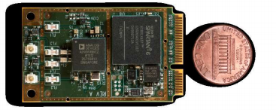
Transceivers w/ GNURadio Source/Sink Support
Epiq Sidekiq
Freq range: 70 MHz – 6 GHz
Resolution: 12-bit
Instantaneous bandwidth: 50 MHz
TX/RX full duplex
2 Channels – phase coherent
MiniPCIe x1 or USB 2.0

Slide 11
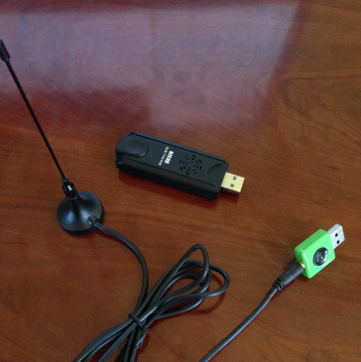
Transceivers w/ GNURadio Source/Sink Support
RTL-SDR
Parameters vary depending on the part
Freq range: ~25 MHz – 2100 MHz
Resolution: 8 bits
Dynamic Range: not provided
Instantaneous bandwidth: 2.56 MHz
Receive only
USB 2.0

Slide 12
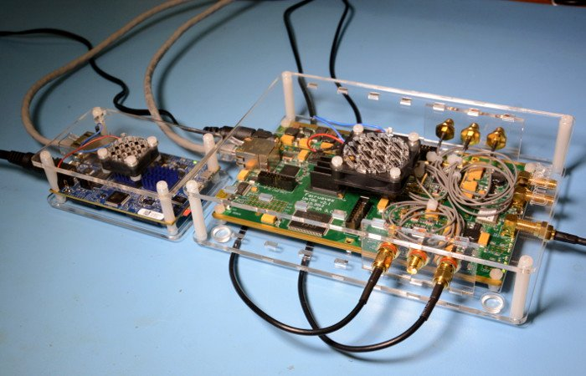
Transceivers w/ GNURadio Source/Sink Support
UmTRX
Freq range: 300 MHz – 3.8 GHz
Resolution: 12-bit
Instantaneous bandwidth: 13 MHz
TX/RX full duplex
2 Channels
Gigabit Ethernet

Slide 13
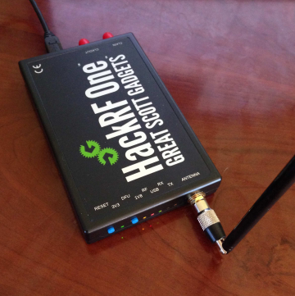
Kickstarted Transceivers
$602,960
HackRF
Freq range: 10 MHz – 6 GHz
Resolution: 8-bit
Instantaneous bandwidth: 8-20 MHz
TX/RX half duplex
2 Channels
USB 2.0

Slide 14
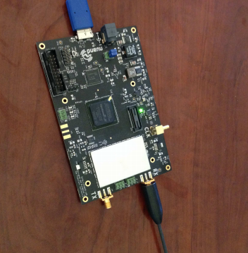
Kickstarted Transceivers
$191,422
BladeRF
Freq range: 300 MHz – 3.8 GHz
Resolution: 12-bit
Instantaneous bandwidth: 28 MHz
TX/RX full duplex
2 Channels
USB 3.0

Slide 15
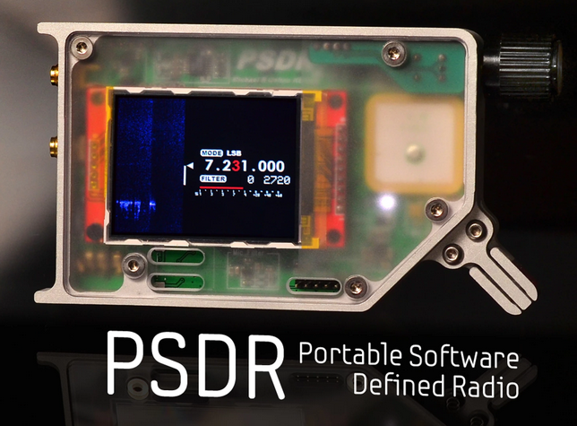
Kickstarted Transceivers
$66,197
PortableSDR – HF/Shortwave
Freq range: 0 MHz – 35 MHz
Instantaneous bandwidth: ? Hz
ARM Processor - ARM Cortex-M4
TX/RX full duplex
GPS onboard
Sweet color LCD screen
USB 2.0

Slide 16
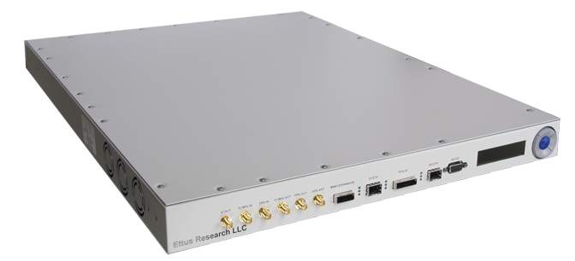
Four Channels!!
Ettus QuadRadio
Freq range: 700 MHz – 4 GHz
Resolution: 16-bit
Instantaneous bandwidth: 60MHz
1,2,3 or 4 RX Channels – Phase coherent
“Stackable” up to 32-channels
2 x 10 GigE

Slide 17
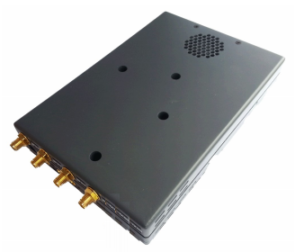
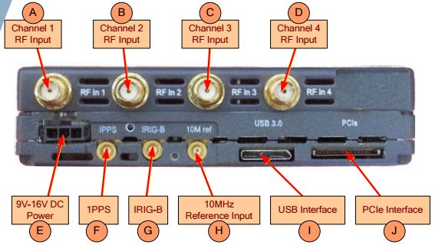
Four Channels!!
SilverPalm SP-830X
Freq range: 300 MHz – 4 GHz
Resolution: 16-bit
Instantaneous bandwidth: 20MHz
TX/RX full duplex
1,2,3 or 4 RX Channels and 1 TX
USB 3.0, PCIe x2, 10GE,
or Thunderbolt

Slide 18
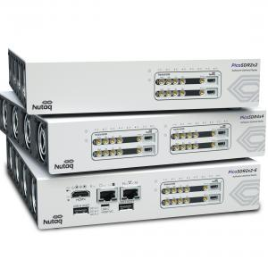
Four Channels!!
Nutaq PicoSDR
Freq range: 300 MHz – 3.8 GHz
Resolution: 12-bit
Instantaneous bandwidth: 1.5 – 28 MHz
TX/RX full duplex
2 or 4 Channels
1 GigE and/or PCIe x4

Slide 19
Interfacing with GNURadio
gr-dubri
gr-baz
gr-osmocom
gr-uhd
gr-sidekiq
DRS
RTL
bladeRF
hackRF
UmTRX
Funcube
USRPs
sidekiq

Slide 20
Questions?

